Slide 1
Process Modeling
Chapter 6
PowerPoint Presentation for Dennis, Wixom, & Roth Systems Analysis and Design, 3rd Edition
Copyright 2006 © John Wiley & Sons, Inc. All rights reserved.
6 - <number>

Slide 2


Key Definitions
Process model
  A formal way of representing how a business system operates
  Illustrates the activities that are performed and how data moves among them
Data flow diagramming
  A common technique for creating process models
PowerPoint Presentation for Dennis, Wixom, & Roth Systems Analysis and Design, 3rd Edition
Copyright 2006 © John Wiley & Sons, Inc. All rights reserved.
6 - <number>

Slide 3
Key Definitions
Logical process models describe processes without suggesting how they are conducted
Physical process models provide information that is needed to build the system
PowerPoint Presentation for Dennis, Wixom, & Roth Systems Analysis and Design, 3rd Edition
Copyright 2006 © John Wiley & Sons, Inc. All rights reserved.
6 - <number>

Slide 4
DATA FLOW DIAGRAMS
PowerPoint Presentation for Dennis, Wixom, & Roth Systems Analysis and Design, 3rd Edition
Copyright 2006 © John Wiley & Sons, Inc. All rights reserved.
6 - <number>

Slide 5
Elements of a DFD
Process - An activity or function performed for a specific business reason, Manual or computerized
Data flow - A single piece of data or a logical collection of data. Always starts or ends at a process
External entity - A person, organization, or system that is external to the system but interacts with it.
Data Store - A collection of data that is stored in some way. Data flowing out is retrieved from the data store. Data flowing in updates or is added to the data store
PowerPoint Presentation for Dennis, Wixom, & Roth Systems Analysis and Design, 3rd Edition
Copyright 2006 © John Wiley & Sons, Inc. All rights reserved.
6 - <number>

Slide 6
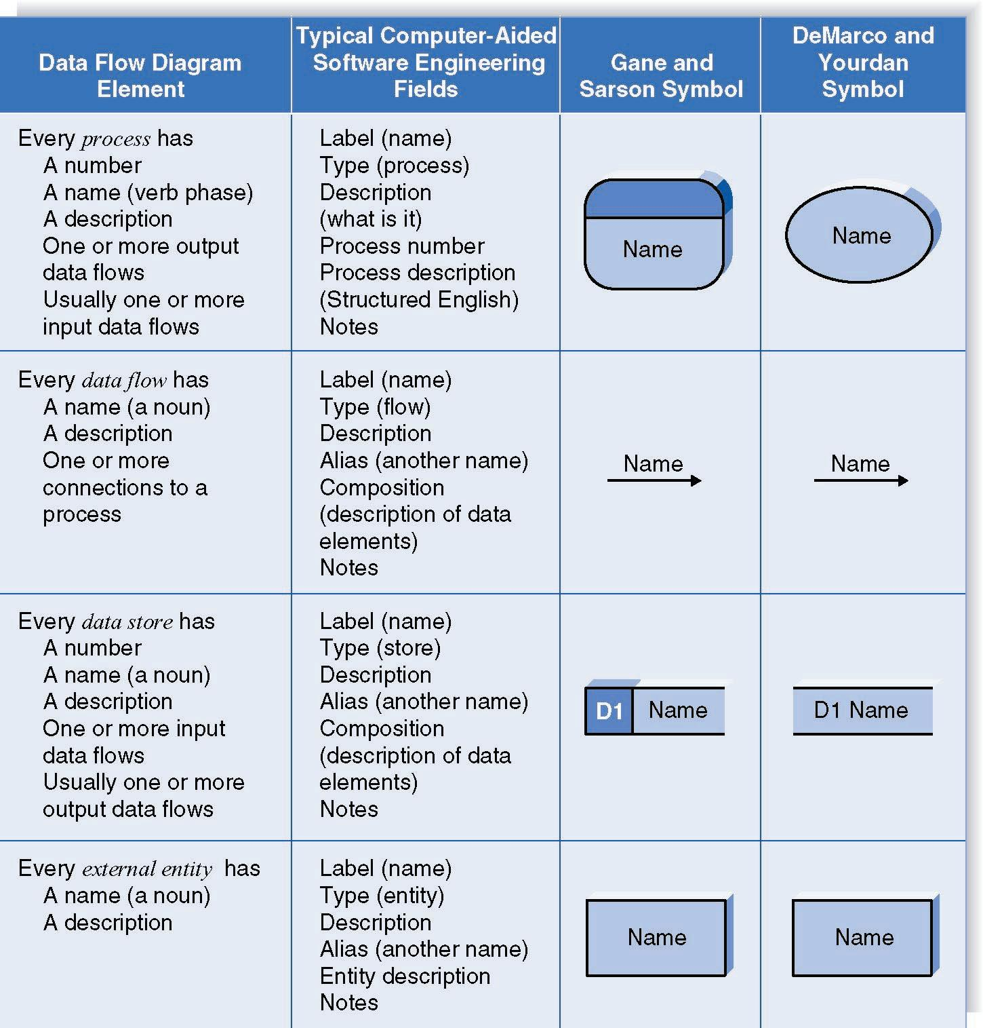
Naming and Drawing DFD Elements
Process
Data flow
Data store
External
entity
PowerPoint Presentation for Dennis, Wixom, & Roth Systems Analysis and Design, 3rd Edition
Copyright 2006 © John Wiley & Sons, Inc. All rights reserved.
6 - <number>

Slide 7
Using a DFD to Define Business Processes
Business processes are too complex to be shown on a single DFD
Decomposition is the process of representing the system in a hierarchy of DFD diagrams
  Child diagrams show a portion of the parent diagram in greater detail

Slide 8
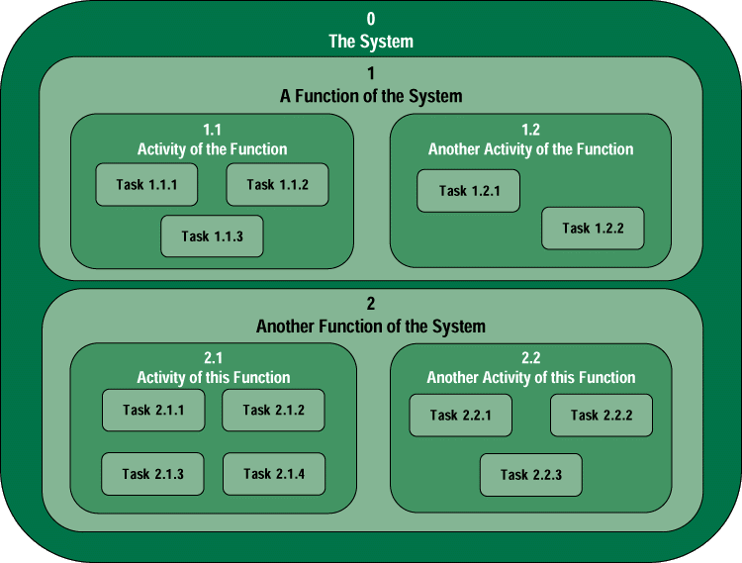
Decomposition
System Decomposition
Decomposition is the act of breaking a system into its component subsystems, processes, and subprocesses. Each level of abstraction reveals more or less detail.
Notes:
Chapter 8 - Process Modeling
No additional notes

Slide 9
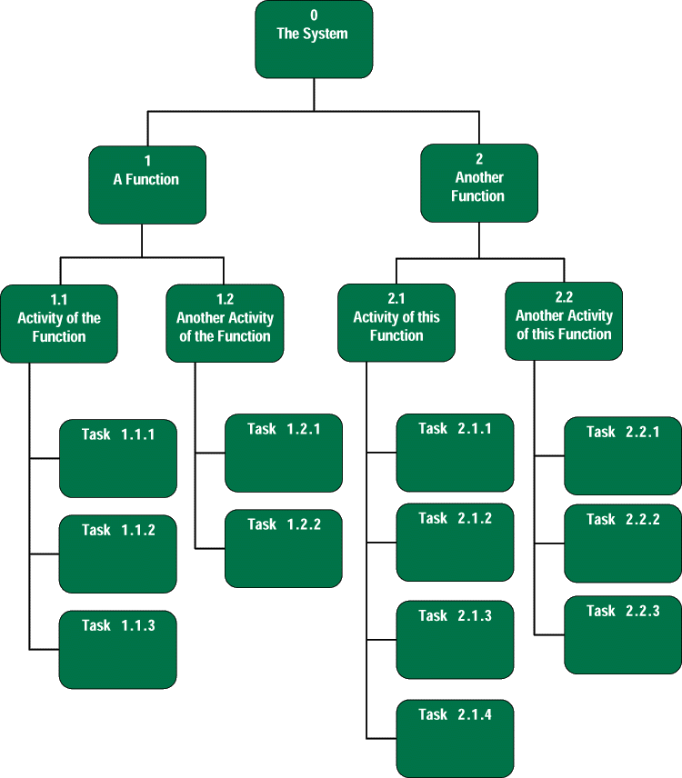
Decomposition Diagrams
A decomposition diagram or hierarchy chart shows the top-down, functional decomposition of a system.
Notes:
Chapter 8 - Process Modeling
Teaching Notes
Decomposition is a top-down problem-solving approach.
It might be useful to point out the numbering scheme. This scheme is common, but we do not like it because if the system is restructured, it forces renumbering all processes.
Some instructors like to do a quick example using a small but realistic problem.

Slide 10
Key Definition
Balancing involves insuring that information presented at one level of a DFD is accurately represented in the next level DFD.
PowerPoint Presentation for Dennis, Wixom, & Roth Systems Analysis and Design, 3rd Edition
Copyright 2006 © John Wiley & Sons, Inc. All rights reserved.
6 - <number>

Slide 11
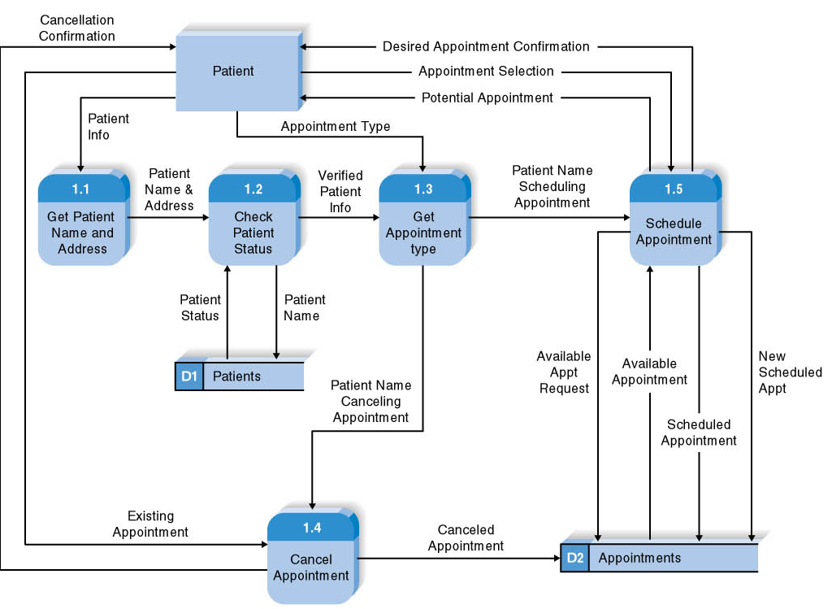
Reading a DFD
PowerPoint Presentation for Dennis, Wixom, & Roth Systems Analysis and Design, 3rd Edition
Copyright 2006 © John Wiley & Sons, Inc. All rights reserved.
6 - <number>

Slide 12
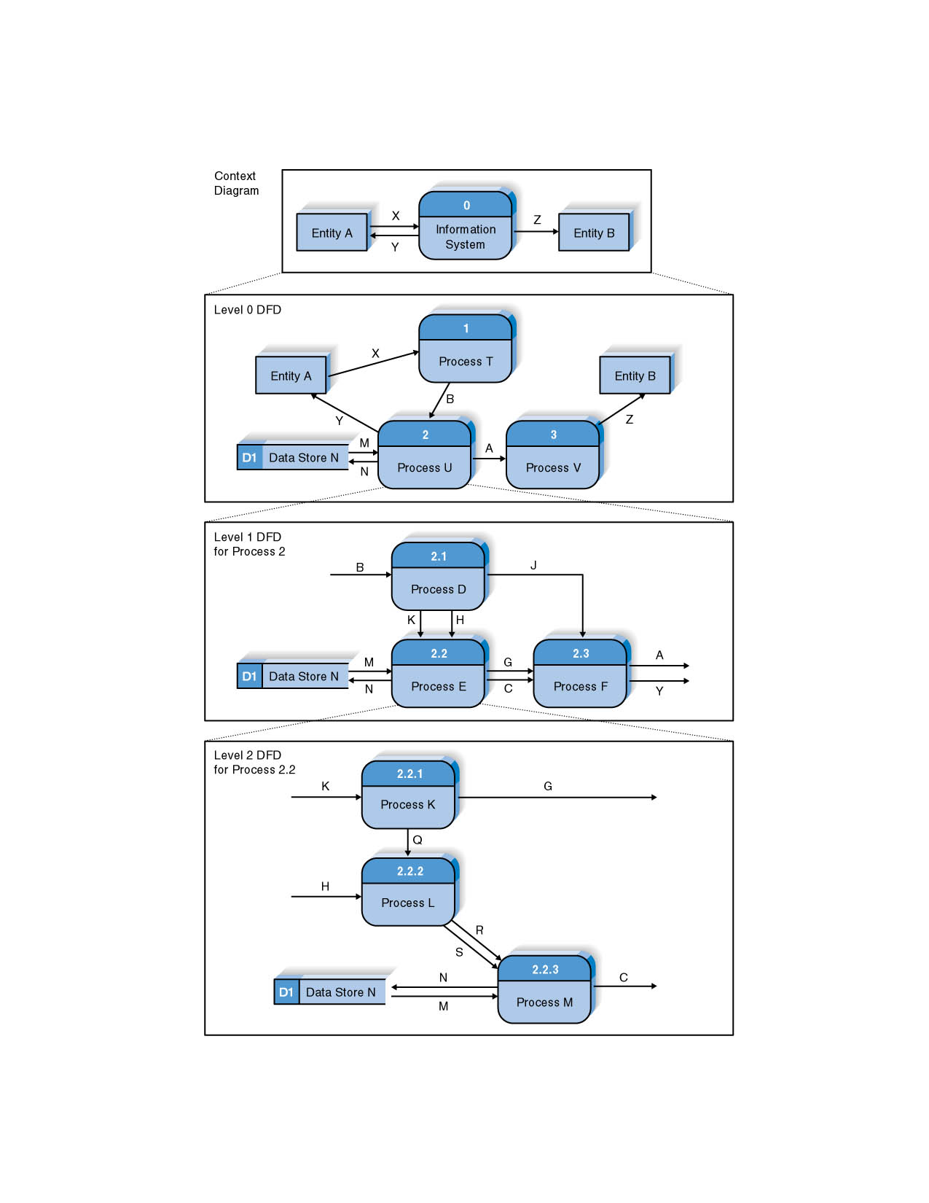
Relationship among Levels of DFDs
Context diagram
Level 0 diagram
Level 1 diagram
Level 2 diagram
PowerPoint Presentation for Dennis, Wixom, & Roth Systems Analysis and Design, 3rd Edition
Copyright 2006 © John Wiley & Sons, Inc. All rights reserved.
6 - <number>

Slide 13
Context Diagram
First DFD in every business process
Shows the context into which the business process fits
Shows the overall business process as just one process (process 0)
Shows all the external entities that receive information from or contribute information to the system
PowerPoint Presentation for Dennis, Wixom, & Roth Systems Analysis and Design, 3rd Edition
Copyright 2006 © John Wiley & Sons, Inc. All rights reserved.
6 - <number>

Slide 14
Level 0 Diagram
Shows all the major processes that comprise the overall system – the internal components of process 0
Shows how the major processes are interrelated by data flows
Shows external entities and the major processes with which they interact
Adds data stores
PowerPoint Presentation for Dennis, Wixom, & Roth Systems Analysis and Design, 3rd Edition
Copyright 2006 © John Wiley & Sons, Inc. All rights reserved.
6 - <number>

Slide 15
Level 1 Diagrams
Generally, one level 1 diagram is created for every major process on the level 0 diagram
Shows all the internal processes that comprise a single process on the level 0 diagram
Shows how information moves from and to each of these processes
If a parent process is decomposed into, for example, three child processes, these three child processes wholly and completely make up the parent process
PowerPoint Presentation for Dennis, Wixom, & Roth Systems Analysis and Design, 3rd Edition
Copyright 2006 © John Wiley & Sons, Inc. All rights reserved.
6 - <number>

Slide 16
Level 2 Diagrams
Shows all processes that comprise a single process on the level 1 diagram
Shows how information moves from and to each of these processes
Level 2 diagrams may not be needed for all level 1 processes
Correctly numbering each process helps the user understand where the process fits into the overall system
PowerPoint Presentation for Dennis, Wixom, & Roth Systems Analysis and Design, 3rd Edition
Copyright 2006 © John Wiley & Sons, Inc. All rights reserved.
6 - <number>

Slide 17
Your Turn
At this point in the process it is easy to lose track of the “big picture”.
Describe the difference between data flows, data stores, and processes.
Describe in your own words the relationship between the DFD and the ultimate new application being developed.
PowerPoint Presentation for Dennis, Wixom, & Roth Systems Analysis and Design, 3rd Edition
Copyright 2006 © John Wiley & Sons, Inc. All rights reserved.
6 - <number>

Slide 18
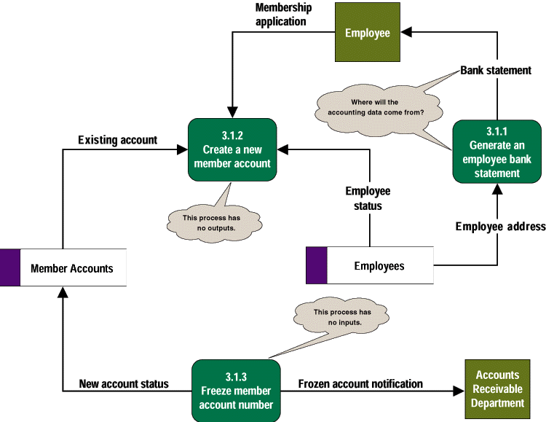
Common Process Errors on DFDs
Notes:
Chapter 8 - Process Modeling
Teaching Tips
Idea: Correct this diagram as an in-class exercise.
3.1.1: To correct the diagram, a data flow, ACCOUNTING DATA, should be added from the data store, MEMBER ACCOUNTS, to process 3.1.1.
3.1.2: To fix the black hole, we might add an output data flow called NEW MEMBER ACCOUNT from process 3.1.2 to the data store MEMBER ACCOUNTS.
3.1.3: To fix the miracle, you would need to at least add a data flow such as ACCOUNTING DATA from the data store, MEMBER ACCOUNTS, to process 3.1.3. In all likelihood, you also need some type of triggering data flow, such as ACCOUNT FREEZE AUTHORIZATION, from a new external agent, such ACCOUNTING DEPARTMENT, to process 3.1 3.

Slide 19
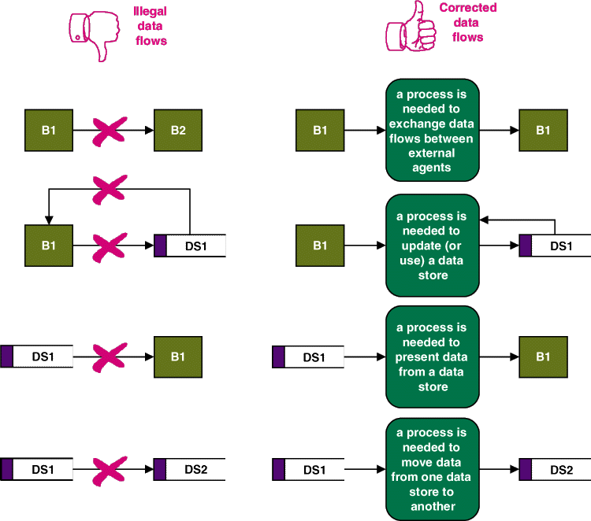
Illegal Data Flows
Notes:
Chapter 8 - Process Modeling
No additional notes

Slide 20
Process Descriptions
Text-based process descriptions provide more information about the process than the DFD alone
If the logic underlying the process is quite complex, more detail may be needed in the form of
  Structured English
  Decision trees
  Decision tables
PowerPoint Presentation for Dennis, Wixom, & Roth Systems Analysis and Design, 3rd Edition
Copyright 2006 © John Wiley & Sons, Inc. All rights reserved.
6 - <number>

Slide 21
CREATING DATA FLOW DIAGRAMS
PowerPoint Presentation for Dennis, Wixom, & Roth Systems Analysis and Design, 3rd Edition
Copyright 2006 © John Wiley & Sons, Inc. All rights reserved.
6 - <number>

Slide 22
Integrating Scenario Descriptions
DFDs start with the use cases and requirements definition
Generally, the DFDs integrate the use cases
Names of use cases become processes
Inputs and outputs become data flows
“Small” data inputs and outputs are combined into a single flow
PowerPoint Presentation for Dennis, Wixom, & Roth Systems Analysis and Design, 3rd Edition
Copyright 2006 © John Wiley & Sons, Inc. All rights reserved.
6 - <number>

Slide 23
Steps in Building DFDs
Build the context diagram
Create DFD fragments for each use case
Organize DFD fragments into level 0 diagram
Decompose level 0 processes into level 1 diagrams as needed; decompose level 1 processes into level 2 diagrams as needed; etc.
Validate DFDs with user to ensure completeness and correctness
PowerPoint Presentation for Dennis, Wixom, & Roth Systems Analysis and Design, 3rd Edition
Copyright 2006 © John Wiley & Sons, Inc. All rights reserved.
6 - <number>

Slide 24
Creating the Context Diagram
Draw one process representing the entire system (process 0)
Find all inputs and outputs listed at the top of the use cases that come from or go to external entities; draw as data flows
Draw in external entities as the source or destination of the data flows
PowerPoint Presentation for Dennis, Wixom, & Roth Systems Analysis and Design, 3rd Edition
Copyright 2006 © John Wiley & Sons, Inc. All rights reserved.
6 - <number>

Slide 25
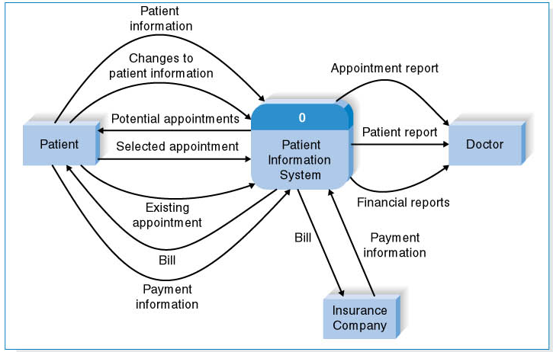
A Context Diagram Example
PowerPoint Presentation for Dennis, Wixom, & Roth Systems Analysis and Design, 3rd Edition
Copyright 2006 © John Wiley & Sons, Inc. All rights reserved.
6 - <number>

Slide 26
Creating DFD Fragments
Each use case is converted into one DFD fragment
Number the process the same as the use case number
Change process name into verb phrase
Design the processes from the viewpoint of the organization running the system
PowerPoint Presentation for Dennis, Wixom, & Roth Systems Analysis and Design, 3rd Edition
Copyright 2006 © John Wiley & Sons, Inc. All rights reserved.
6 - <number>

Slide 27
Creating DFD Fragments
Add data flows to show use of data stores as sources and destinations of data
Layouts typically place
  processes in the center
  inputs from the left
  outputs to the right
  stores beneath the processes
PowerPoint Presentation for Dennis, Wixom, & Roth Systems Analysis and Design, 3rd Edition
Copyright 2006 © John Wiley & Sons, Inc. All rights reserved.
6 - <number>

Slide 28
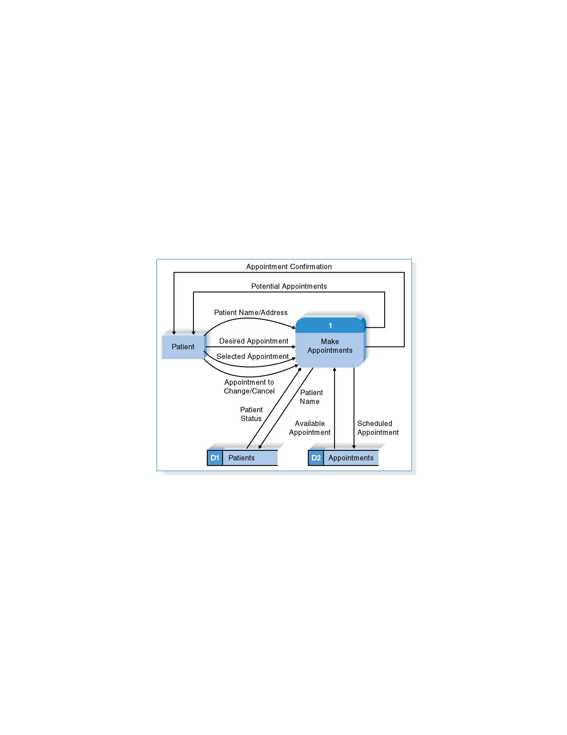
A DFD Fragment Example
PowerPoint Presentation for Dennis, Wixom, & Roth Systems Analysis and Design, 3rd Edition
Copyright 2006 © John Wiley & Sons, Inc. All rights reserved.
6 - <number>

Slide 29
Creating the Level 0 Diagram
Combine the set of DFD fragments into one diagram
Generally move from top to bottom, left to right
Minimize crossed lines
Iterate as needed
  DFDs are often drawn many times before being finished, even with very experienced systems analysts
PowerPoint Presentation for Dennis, Wixom, & Roth Systems Analysis and Design, 3rd Edition
Copyright 2006 © John Wiley & Sons, Inc. All rights reserved.
6 - <number>

Slide 30
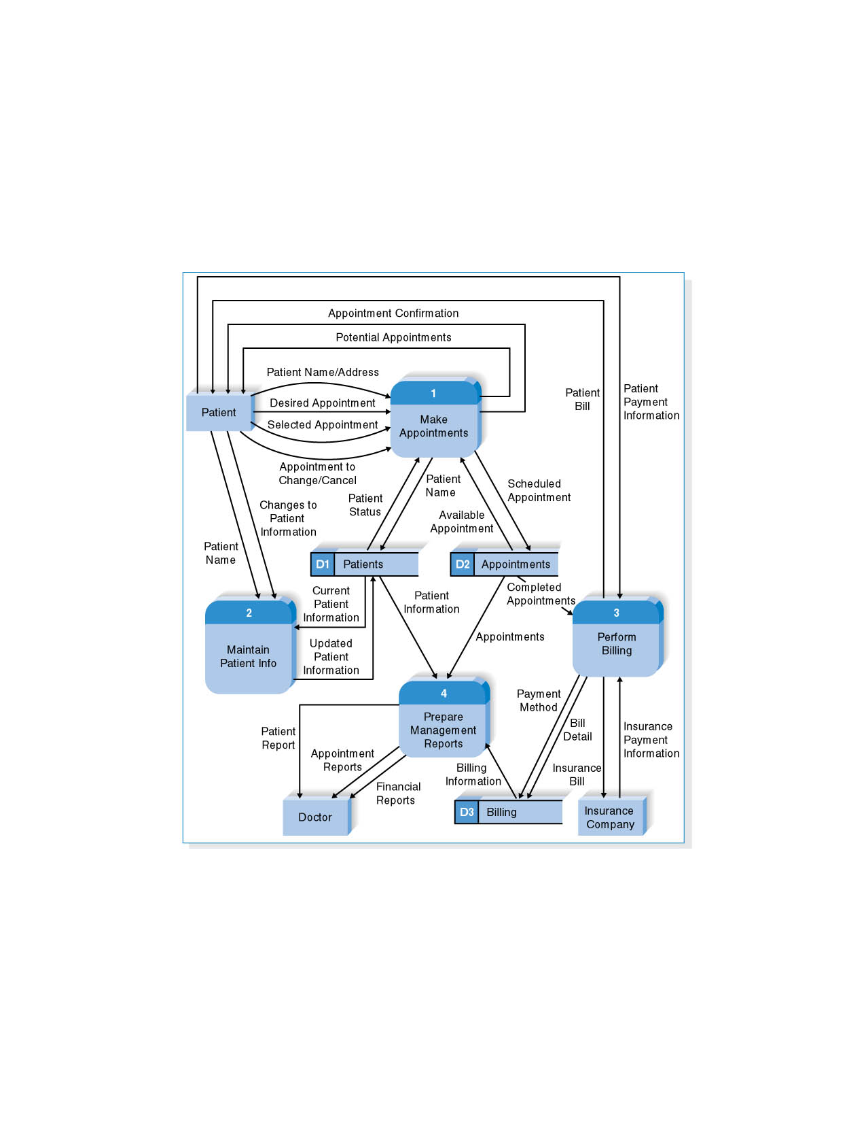
A Level 0 DFD Example
PowerPoint Presentation for Dennis, Wixom, & Roth Systems Analysis and Design, 3rd Edition
Copyright 2006 © John Wiley & Sons, Inc. All rights reserved.
6 - <number>

Slide 31
Creating Level 1 Diagrams (and Below)
Each use case is turned into its own DFD
Take the steps listed on the use case and depict each as a process on the level 1 DFD
Inputs and outputs listed on use case become data flows on DFD
Include sources and destinations of data flows to processes and stores within the DFD
May also include external entities for clarity
PowerPoint Presentation for Dennis, Wixom, & Roth Systems Analysis and Design, 3rd Edition
Copyright 2006 © John Wiley & Sons, Inc. All rights reserved.
6 - <number>

Slide 32
Creating Level 1 Diagrams (and Below)
When to stop decomposing DFDs?
  Ideally, a DFD has at least three processes and no more than seven to nine.
PowerPoint Presentation for Dennis, Wixom, & Roth Systems Analysis and Design, 3rd Edition
Copyright 2006 © John Wiley & Sons, Inc. All rights reserved.
6 - <number>

Slide 33
Validating the DFD
Syntax errors – diagram follows the rules
  Assure correct DFD structure
For each DFD:
Check each process for:
A unique name: action verb phrase; number; description
        At least one input data flow
        At least one output data flow
        Output data flow names usually different than
        input data flow names
        Between 3 and 7 processes per DFD
PowerPoint Presentation for Dennis, Wixom, & Roth Systems Analysis and Design, 3rd Edition
Copyright 2006 © John Wiley & Sons, Inc. All rights reserved.
6 - <number>

Slide 34
Validating the DFD
For each DFD:
Check each data flow for:
A unique name: noun; description
Connects to at least one process
Shown in only one direction (no two-headed arrows)
A minimum number of crossed lines
Check each data store for:
A unique name: noun; description
At least one input data flow
At least one output data flow
Check each external entity for:
A unique name: noun; description
At least one input or output data flow
PowerPoint Presentation for Dennis, Wixom, & Roth Systems Analysis and Design, 3rd Edition
Copyright 2006 © John Wiley & Sons, Inc. All rights reserved.
6 - <number>

Slide 35
Validating the DFD
Across DFDs:
Context Diagram:
Every set of DFDs must have one Context Diagram
Viewpoint:
There is a consistent viewpoint for the entire set of DFDs
Decomposition:
Every process is wholly and complete described by the
processes on its children DFDs
Balance:
Every data flow, data store, and external entity on a higher level
DFD is shown on the lower level DFD that decomposes it
No data stores or data flows appear on lower-lever DFDs that do
not appear on their parent DFD
PowerPoint Presentation for Dennis, Wixom, & Roth Systems Analysis and Design, 3rd Edition
Copyright 2006 © John Wiley & Sons, Inc. All rights reserved.
6 - <number>

Slide 36
Validating the DFD
Semantics errors – diagram conveys correct meaning
  Assure accuracy of DFD relative to actual/desired business processes
Examine lowest level DFDs to ensure consistent decomposition
Examine names carefully to ensure consistent use of terms
PowerPoint Presentation for Dennis, Wixom, & Roth Systems Analysis and Design, 3rd Edition
Copyright 2006 © John Wiley & Sons, Inc. All rights reserved.
6 - <number>

Slide 37
A Quick Review of Decomposition for Holiday Travel Vehicle Sales System
PowerPoint Presentation for Dennis, Wixom, & Roth Systems Analysis and Design, 3rd Edition
Copyright 2006 © John Wiley & Sons, Inc. All rights reserved.
6 - <number>

Slide 38
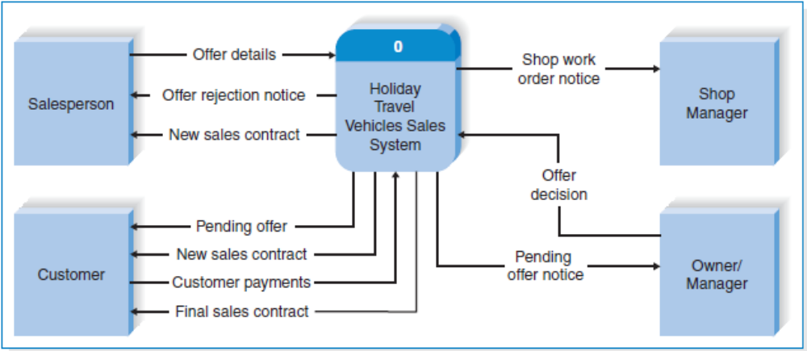
Holiday Travel Vehicle Sales System Context Diagram
PowerPoint Presentation for Dennis, Wixom, & Roth Systems Analysis and Design, 3rd Edition
Copyright 2006 © John Wiley & Sons, Inc. All rights reserved.
6 - <number>

Slide 39
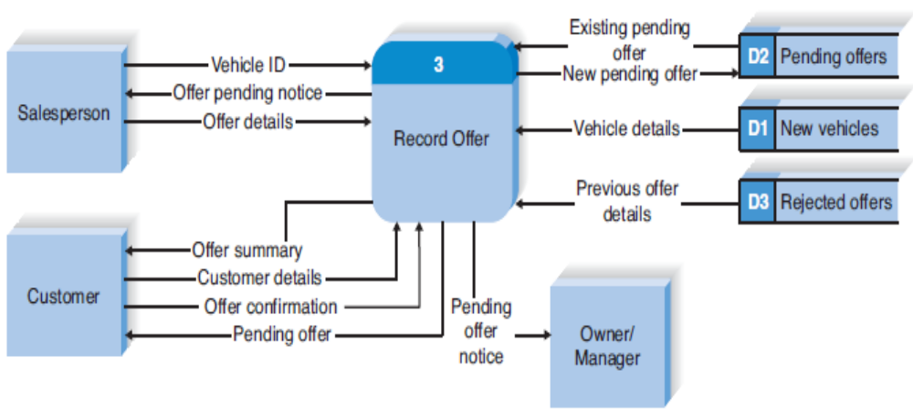
HTV Record Offer DFD Fragment
PowerPoint Presentation for Dennis, Wixom, & Roth Systems Analysis and Design, 3rd Edition
Copyright 2006 © John Wiley & Sons, Inc. All rights reserved.
6 - <number>

Slide 40
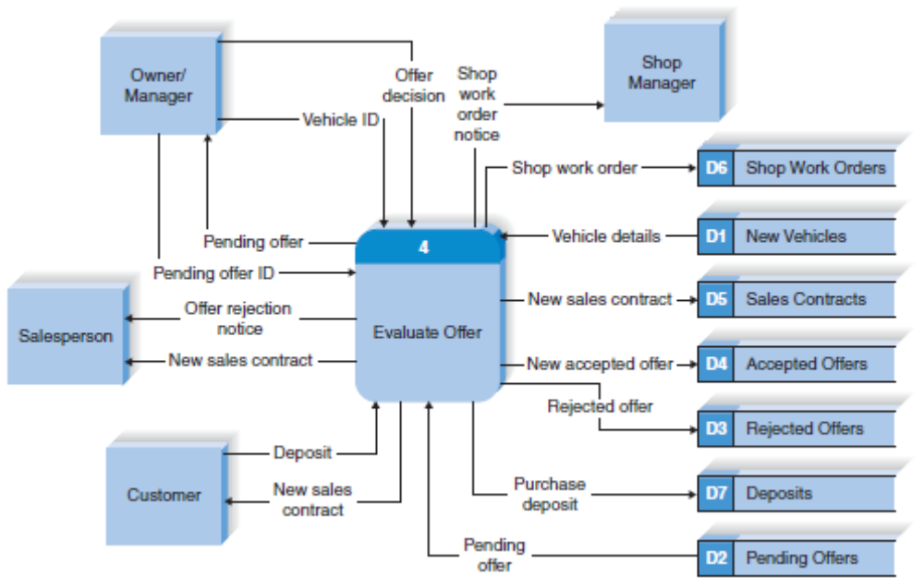
HTV Evaluate Offer DFD Fragment
PowerPoint Presentation for Dennis, Wixom, & Roth Systems Analysis and Design, 3rd Edition
Copyright 2006 © John Wiley & Sons, Inc. All rights reserved.
6 - <number>

Slide 41
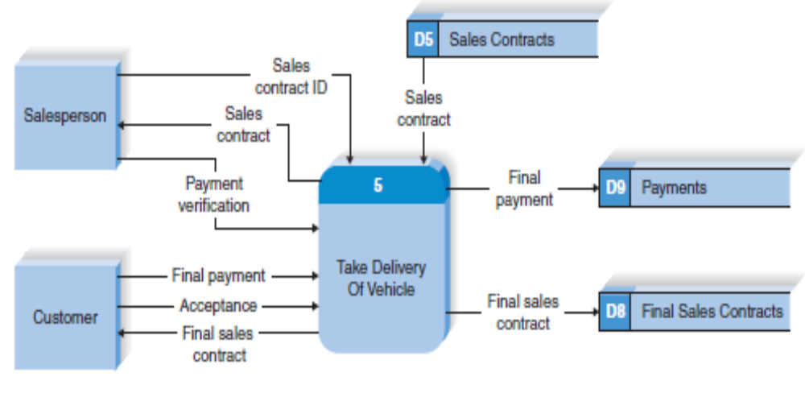
HTV Take Delivery of Vehicle DFD Fragment
PowerPoint Presentation for Dennis, Wixom, & Roth Systems Analysis and Design, 3rd Edition
Copyright 2006 © John Wiley & Sons, Inc. All rights reserved.
6 - <number>

Slide 42
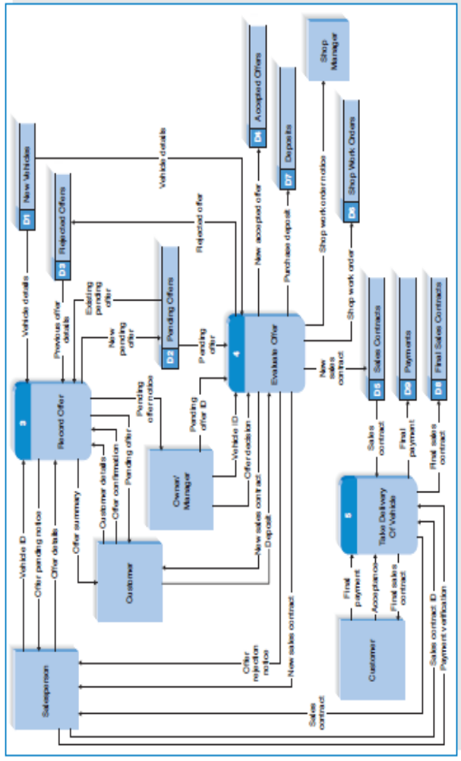
Level 0 DFD for HTV
PowerPoint Presentation for Dennis, Wixom, & Roth Systems Analysis and Design, 3rd Edition
Copyright 2006 © John Wiley & Sons, Inc. All rights reserved.
6 - <number>

Slide 43
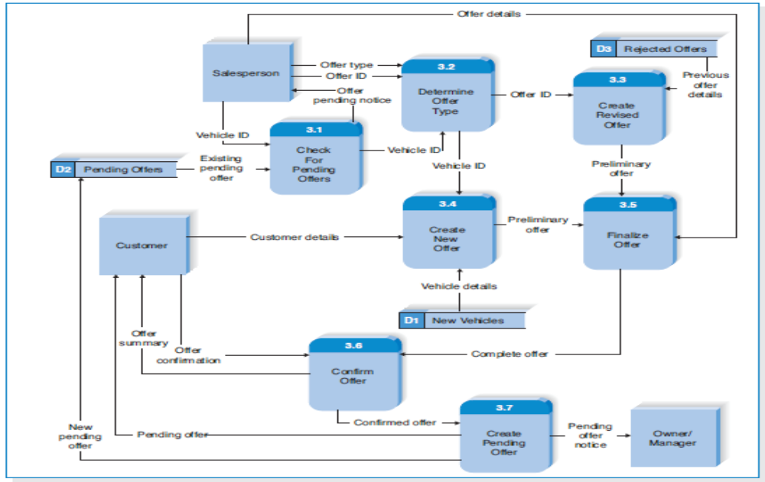
Level 1 DFD for HTV Record Offer process
PowerPoint Presentation for Dennis, Wixom, & Roth Systems Analysis and Design, 3rd Edition
Copyright 2006 © John Wiley & Sons, Inc. All rights reserved.
6 - <number>

Slide 44
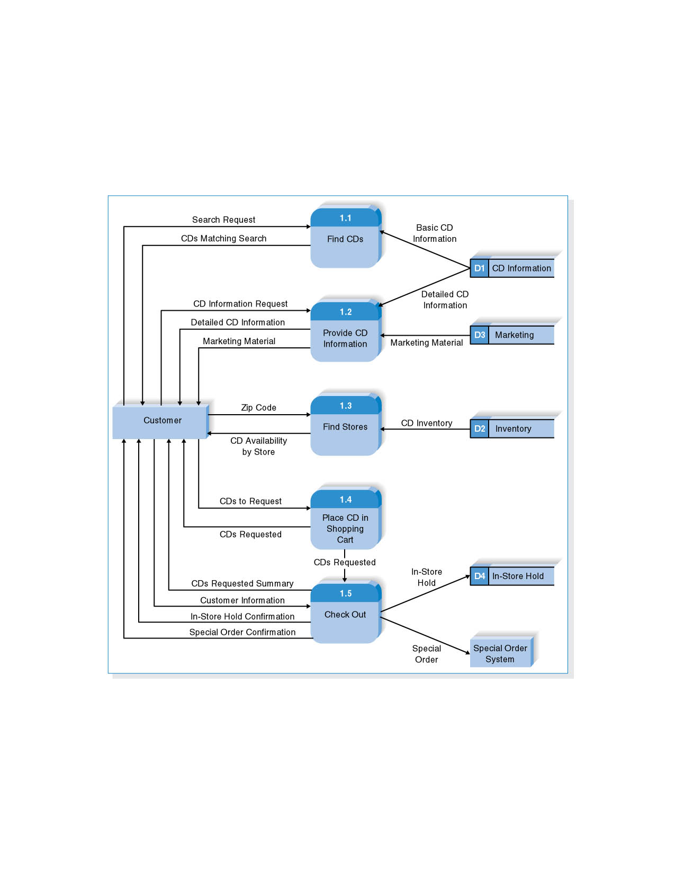
Level 1 DFD for CD Selections Process 1: Take Requests
PowerPoint Presentation for Dennis, Wixom, & Roth Systems Analysis and Design, 3rd Edition
Copyright 2006 © John Wiley & Sons, Inc. All rights reserved.
6 - <number>

Slide 45
Exercise
Draw a level 0 data flow diagram (DFD) for the dentist office system in the previous chapter.
PowerPoint Presentation for Dennis, Wixom, & Roth Systems Analysis and Design, 3rd Edition
Copyright 2006 © John Wiley & Sons, Inc. All rights reserved.
6 - <number>

Slide 46
Summary
The Data Flow Diagram (DFD) is an essential tool for creating formal descriptions of business processes.
Use cases record the input, transformation, and output of business processes and are the basis for process models.
Eliciting use cases and modeling business processes are critically important skills for the systems analyst to master.
PowerPoint Presentation for Dennis, Wixom, & Roth Systems Analysis and Design, 3rd Edition
Copyright 2006 © John Wiley & Sons, Inc. All rights reserved.
6 - <number>

